Slide 1
CHRISTINE & ANANT’S WEDDING
NOVEMBER 29TH, 2025: PAVILLON DAUPHINE
WEDDING MOOD BOARD

Slide 2
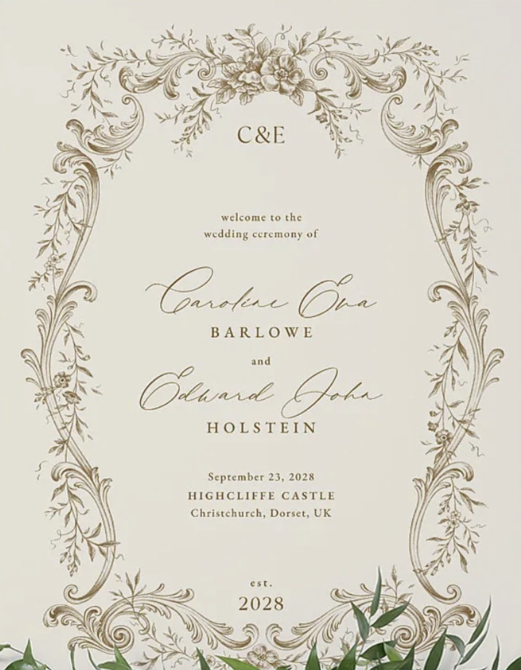
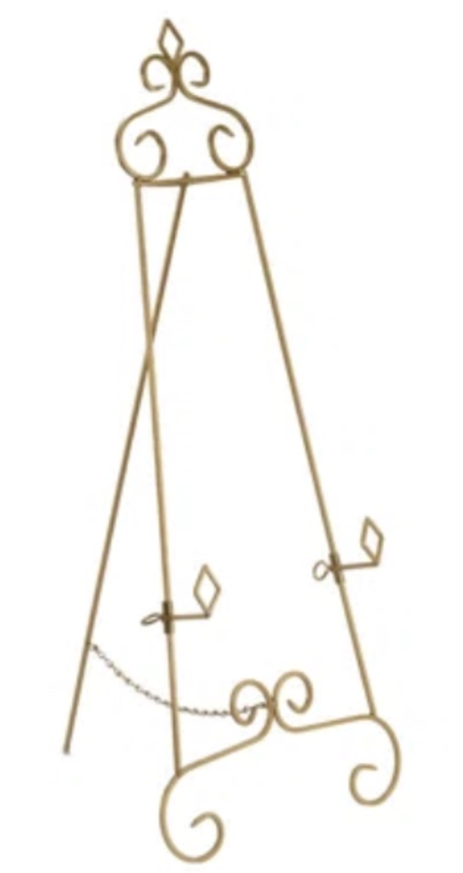
Welcome Sign & Décor
Cream color poster with similar design & font color to inspiration photo and Antique gold baroque style stand

Slide 3
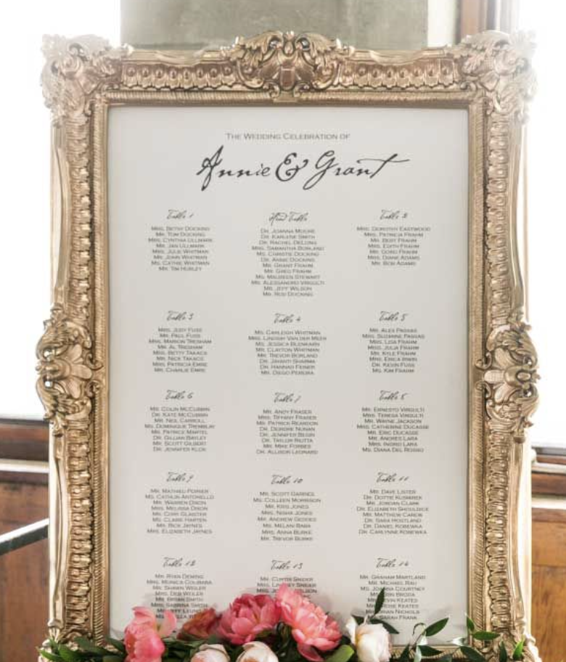
Seating Chart
Baroque gold frame (no flowers)
Cream color poster with dark brown script font (match to color of Welcome sign)

Slide 4
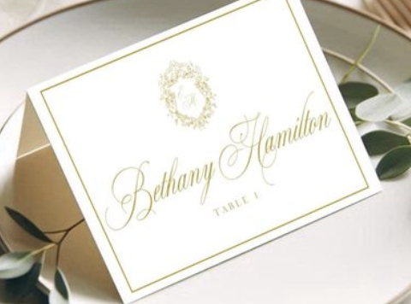
Place Cards
Audrey’s Note:
Please note that place cards are required by the catering staff regardless of round or rectangular tables. For weddings with more than 100 guests, place cards must be placed on each table with assigned seating, showing each guest’s full name, table number, and a meal icon/allergy note to guide the staff.

Slide 5
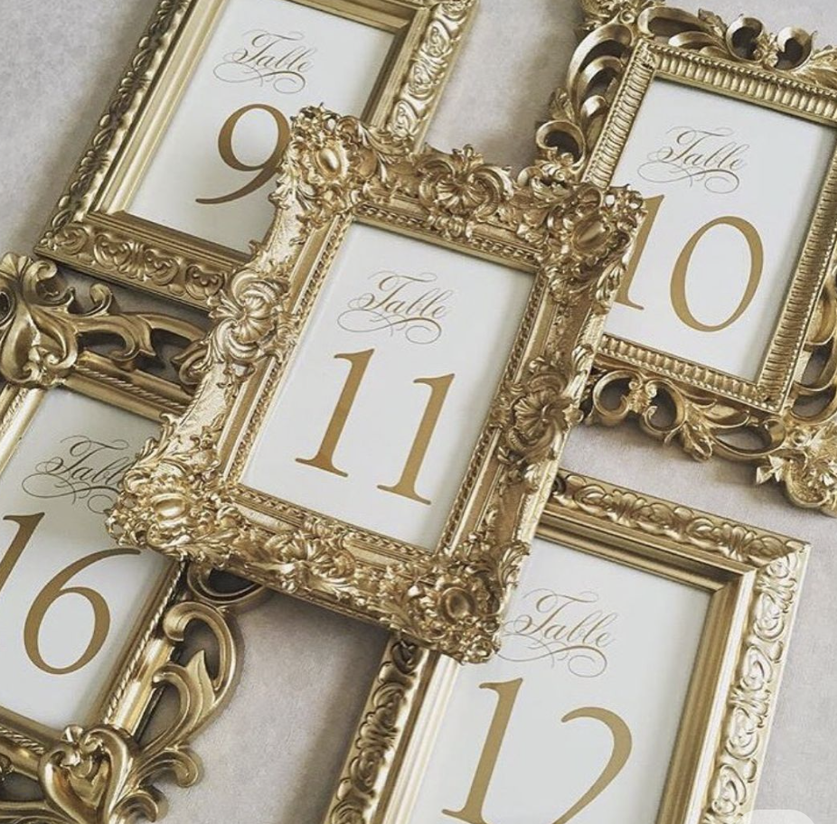
Table numbers
Antique gold Baroque style picture frame with cream paper and dark brown script font

Slide 6
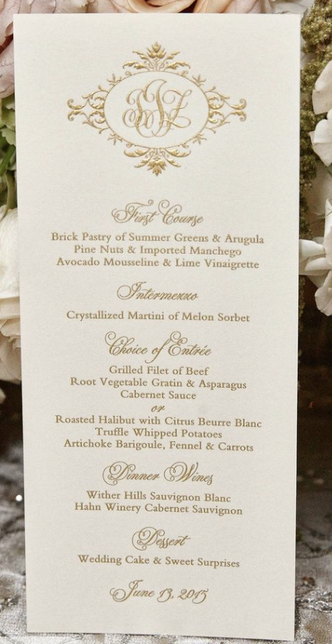
Menus
Long rectangular shape
Cream colored smooth matte thick stock paper with dark brown script font
Baroque style design at top and bottom

Slide 7
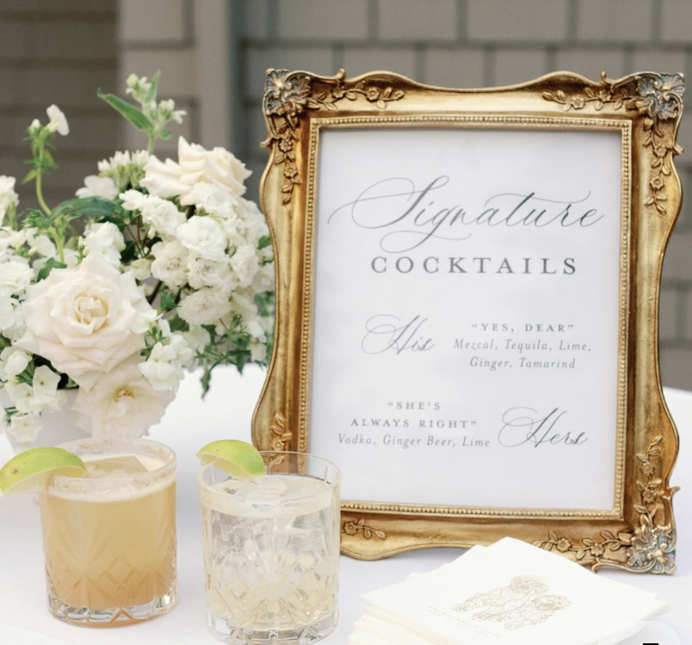
Bar Menus
Antique gold Baroque style picture frame with cream paper and dark brown script font

Slide 8
NOTES FOR PLANNER AND FLORIST TEAM ONLY (FRENCH):
1 Welcome sign + chevalet doré
1 Seating Chart + chevalet doré – a confirmer si par table ou par ordre alphabetique.
125 place cards excitement comme sur la photo, nom complet + table + icon pour le repas
NOTE: dans l’insigne du haut, ajouter les initiales des mariés A & C
Numero de table – nombre a determine suivant le nombre de table et la deco finale
125 menus – le but est de retrouver le meme style que les place cards et d’ajouter a l’insigne les initiales des mariés A & C
2 Menus de Bars (1 pour le cocktail - 1 pour la réception/fête)

